Slide 1
Language, Script, Orthography, and Text-input
Rating Text-input Difficulty Across Languages
Hugh Paterson III 15 November 2022

Slide 2
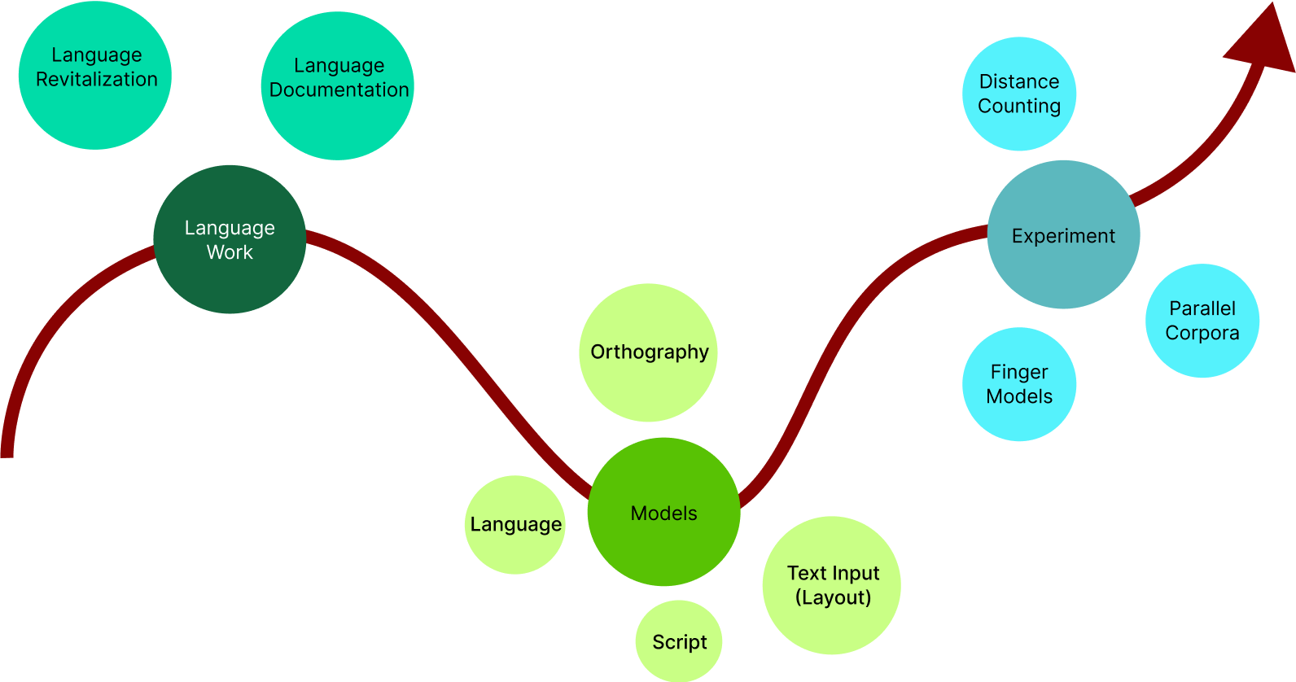
TopicMap

Slide 3
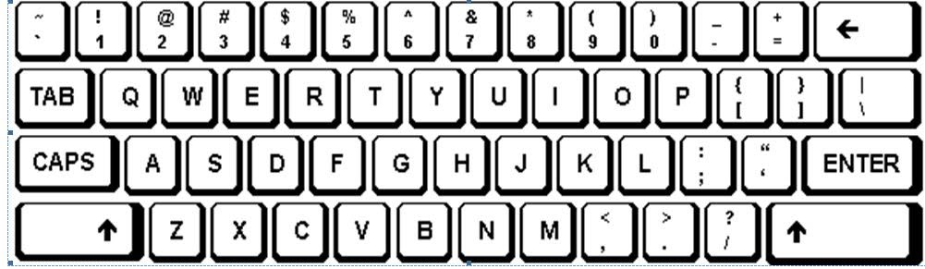
TopicMap

Slide 4
The Economics of Linguistic Exchanges
Language as Instrument
Language as Object
Bourdieu, Pierre. 1977. “The economics of linguistic exchanges.” Social Science Information 16(6). 645–668. doi:10.1177/053901847701600601
Notes:
Bourdieu, Pierre. 1977. “The economics of linguistic exchanges.” Social Science Information 16(6). 645–668. doi:10.1177/053901847701600601

Slide 5
Broad Categories for Language Resources
Undocumented-Undescribed
Language Documentation
Language as Instrument
Language as Object
Language Development
Language Description
Notes:
Bourdieu, Pierre. 1977. “The economics of linguistic exchanges”. Social Science Information 16(6). 645–668. doi:10.1177/053901847701600601
Himmelmann, Nikolaus P. 1998. “Documentary and Descriptive Linguistics.” Linguistics 36 (1): 161–95. doi:10.1515/ling.1998.36.1.161.
Himmelmann, Nikolaus P. 2012. “Linguistic Data Types and the Interface between Language Documentation and Description.” Language Documentation & Conservation 6 (1): 187–207. http://hdl.handle.net/10125/4503.

Slide 6
Broad Categories for Language Resources
Undocumented-Undescribed
Language Documentation
Language as Instrument
Language as Object
Language Development
Language Description
Notes:
Bourdieu, Pierre. 1977. The economics of linguistic exchanges. Social Science Information 16(6). 645–668. doi:10.1177/053901847701600601

Slide 7
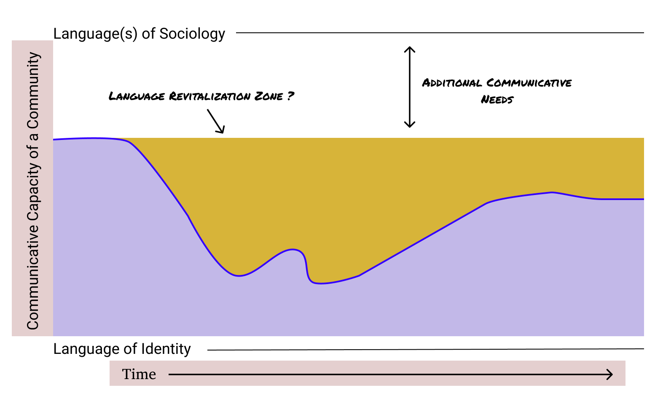
Broad Categories for Language Resources
Undocumented-Undescribed
Language Documentation
Language Development
Language Description
Notes:
Ferguson, Charles A. 1968. “Language Development.” In Language Problems of Developing Nations, edited by Joshua A. Fishman, Charles A. Ferguson, and J. Das Gupta, 27–36. New York: Wiley and Sons.
Fishman, Joshua A. 1968. “Language Problems and Types of Political and Socio-Cultural Integration: A Conceptual Postscript.” In a report on the Ninth International Conference on Second Language Problems, (Tunis, 24–27 April). London, England: English-Teaching Information Centre. https://eric.ed.gov/?id=ED025739.
Fishman, Joshua A. 1980. “Ethnocultural Dimensions in the Acquisition and Retention of Biliteracy.” Journal of Basic Writing 3 (1): 48–61. doi:10.37514/JBW-J.1980.3.1.05.
Obiero, Ogone John. 2010. “From Assessing Language Endangerment or Vitality to Creating and Evaluating Language Revitalization Programmes.” Nordic Journal of African Studies 19 (4): 201–26.

Slide 8
Broad Categories for Language Resources
Notes:
Ferguson, Charles A. 1968. “Language Development.” In Language Problems of Developing Nations, edited by Joshua A. Fishman, Charles A. Ferguson, and J. Das Gupta, 27–36. New York: Wiley and Sons.
Fishman, Joshua A. 1968. “Language Problems and Types of Political and Socio-Cultural Integration: A Conceptual Postscript.” In a report on the Ninth International Conference on Second Language Problems, (Tunis, 24–27 April). London, England: English-Teaching Information Centre. https://eric.ed.gov/?id=ED025739.
Lenore Grenoble.2009. —Language domains— Lenore Grenoble 2016 ideological classification
Fishman, Joshua A. 1980. “Ethnocultural Dimensions in the Acquisition and Retention of Biliteracy.” Journal of Basic Writing 3 (1): 48–61. doi:10.37514/JBW-J.1980.3.1.05.
Obiero, Ogone John. 2010. “From Assessing Language Endangerment or Vitality to Creating and Evaluating Language Revitalization Programmes.” Nordic Journal of African Studies 19 (4): 201–26.

Slide 9
Broad Categories for Language Resources
Undocumented-Undescribed
Language Documentation
Language Development
Language Description
Notes:
Ferguson, Charles A. 1968. “Language Development.” In Language Problems of Developing Nations, edited by Joshua A. Fishman, Charles A. Ferguson, and J. Das Gupta, 27–36. New York: Wiley and Sons.
Fishman, Joshua A. 1968. “Language Problems and Types of Political and Socio-Cultural Integration: A Conceptual Postscript.” In a report on the Ninth International Conference on Second Language Problems, (Tunis, 24–27 April). London, England: English-Teaching Information Centre. https://eric.ed.gov/?id=ED025739.
Fishman, Joshua A. 1980. “Ethnocultural Dimensions in the Acquisition and Retention of Biliteracy.” Journal of Basic Writing 3 (1): 48–61. doi:10.37514/JBW-J.1980.3.1.05.
Obiero, Ogone John. 2010. “From Assessing Language Endangerment or Vitality to Creating and Evaluating Language Revitalization Programmes.” Nordic Journal of African Studies 19 (4): 201–26.

Slide 10
A Useful Model for Languages and Scripts
Notes:
Constable, P. (2002). Toward a Model for Language Identification Defining an ontology of language-related categories. SIL Electronic Working Papers, 2002-003. Retrieved from https://www.sil.org/resources/publications/entry/7853

Slide 11
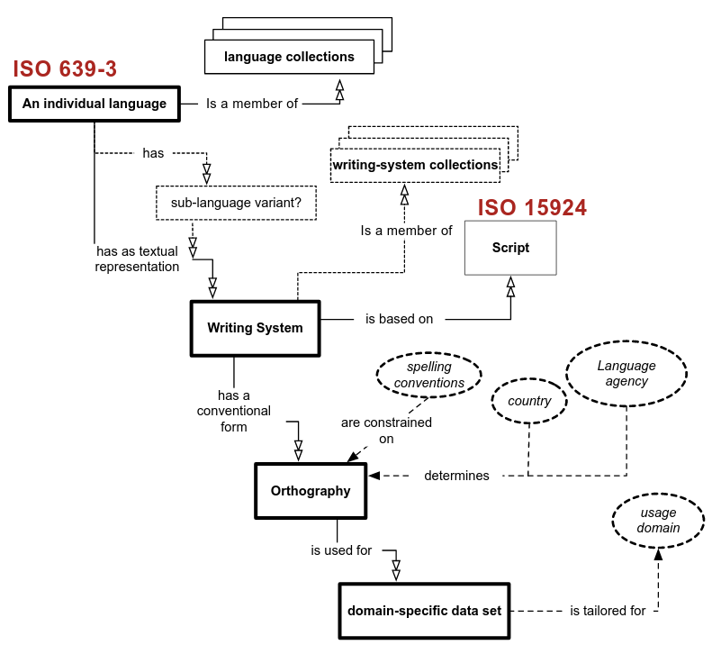
A Useful Model for Languages and Scripts
Notes:
Constable, P. (2002). Toward a Model for Language Identification Defining an ontology of language-related categories. SIL Electronic Working Papers, 2002-003. Retrieved from https://www.sil.org/resources/publications/entry/7853

Slide 12
A Useful Model for Languages and Scripts
Notes:
Constable, P. (2002). Toward a Model for Language Identification Defining an ontology of language-related categories. SIL Electronic Working Papers, 2002-003. Retrieved from https://www.sil.org/resources/publications/entry/7853

Slide 13
A Useful Model for Languages and Scripts
}
English: ____________
Both Latin Script; Different Writing Systems
German: äÄ, öÖ, üÜ, ß
Notes:
Constable, P. (2002). Toward a Model for Language Identification Defining an ontology of language-related categories. SIL Electronic Working Papers, 2002-003. Retrieved from https://www.sil.org/resources/publications/entry/7853

Slide 14
A Useful Model for Languages and Scripts
}
English: ____________
Both Latin Script; Different Writing Systems
German: äÄ, öÖ, üÜ, ß
British English
American English
}
German prior to 1996
German post 1996
German in Switzerland
Notes:
Constable, P. (2002). Toward a Model for Language Identification Defining an ontology of language-related categories. SIL Electronic Working Papers, 2002-003. Retrieved from https://www.sil.org/resources/publications/entry/7853

Slide 15
A Useful Model for Languages and Scripts
}
English: ____________
Both Latin Script; Different Writing Systems
German: äÄ, öÖ, üÜ, ß
British English
American English
}
German prior to 1996
German post 1996
German in Switzerland
Notes:
Constable, P. (2002). Toward a Model for Language Identification Defining an ontology of language-related categories. SIL Electronic Working Papers, 2002-003. Retrieved from https://www.sil.org/resources/publications/entry/7853

Slide 16
A Useful Model for Languages and Scripts
}
English: ____________
Both Latin Script; Different Writing Systems
German: äÄ, öÖ, üÜ, ß
British English
American English
}
German prior to 1996
German post 1996
German in Switzerland
}
Newspaper Articles
Library Records
Interlinear-Glossed Texts
Notes:
Constable, P. (2002). Toward a Model for Language Identification Defining an ontology of language-related categories. SIL Electronic Working Papers, 2002-003. Retrieved from https://www.sil.org/resources/publications/entry/7853

Slide 17
Text Input

Slide 18

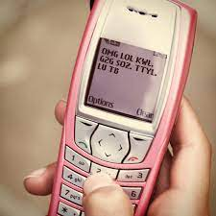

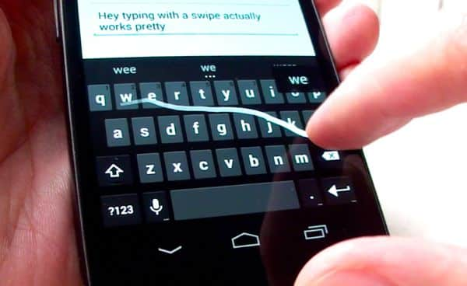
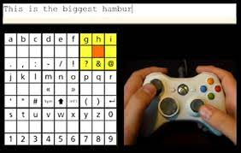
Text Input
Speech-to-text
Predictive models—T9
Swipe based
Eye gaze
Thumb based cell-phones
Stylus based
Controller based

Slide 19

Keyboards

Slide 20
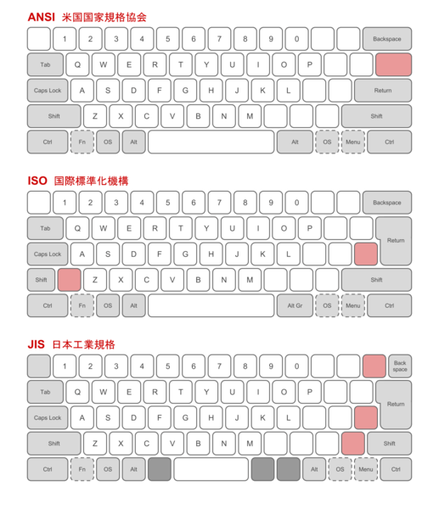
Keyboards

Slide 21
A Reference to the Abstract
Would a certain text be easier to type in:
English [eng],
French [fra], or
Eastern Dan [dnj]?
Dear brothers and sisters, when troubles come your way, consider it an opportunity for great joy.
Estimez-le comme une parfaite joie, mes frères, quand vous serez en butte à diverses tentations, sachant que l’épreuve de votre foi produit la patience.
‐A pö 'a‐ wo "dhʋ̈ bha‐ 'klɔɔ‐ ‐mü ꞊dhɛ ‐a ‐dhɛa ‐bha ꞊dhɛ ‐yö kë ka "yaan ꞊dhɛ 'wɔn "gbɩɩgbɩɩ‐ ‐nu bha ꞊në‐ ꞊gban ꞊ya 'kun bho ka 'gü ka ‐bha 'dhang ‐bho Yesu "dhiʋ̈ ‐sü bha‐ 'gü, 'yö dho ka gba zuësɛadhɛ 'ka.
Notes:
Bird, Steven (1999). When marking tone reduces fuency: an orthography experiment in Cameroon. Language and Speech 42: 83–115.
Roberts, David. 2011. “A Tone Orthography Typology.” Written Language & Literacy 14 (1): 82–108. doi:10.1075/wll.14.1.05rob.

Slide 22
Tone Orthographies in Latin Scripts I
Roberts (2011) A Tone Orthography Typology. — a must read for anyone working on developing a tonal orthography in a latin script.
Domain
Target
Symbol
Position
Density
Depth
Density: Some orthographies represent tone exhaustively, that is to say every tone bearing unit carries a symbol for tone, so tone diacritic density is 100%. (p.92)
Tone diacritic density is precisely quantifiable by calculating the number of tone diacritics in a natural text (100 word sample) as a percentage of the number of tone bearing units (Bird 1999: 89). (Roberts p. 90)
‐A pö 'a‐ wo "dhʋ̈ bha‐ 'klɔɔ‐ ‐mü ꞊dhɛ ‐a ‐dhɛa ‐bha ꞊dhɛ ‐yö kë ka "yaan ꞊dhɛ 'wɔn "gbɩɩgbɩɩ‐ ‐nu bha ꞊në‐ ꞊gban ꞊ya 'kun bho ka 'gü ka ‐bha 'dhang ‐bho Yesu "dhiʋ̈ ‐sü bha‐ 'gü, 'yö dho ka gba zuësɛadhɛ 'ka.
Notes:
Bird, Steven (1999). When marking tone reduces fuency: an orthography experiment in Cameroon. Language and Speech 42: 83–115.
Roberts, David. 2011. “A Tone Orthography Typology.” Written Language & Literacy 14 (1): 82–108. doi:10.1075/wll.14.1.05rob.

Slide 23
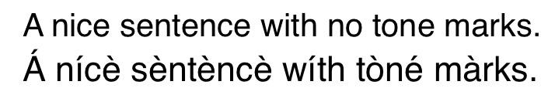
Tone Orthographies in Latin Scripts II
Zero Tone Marking
Exhaustive Tone Marking
Notes:
Bird, Steven. 1999. “When marking tone reduces fuency: an orthography experiment in Cameroon.” Language and Speech 42: 83–115.
Roberts, David. 2011. “A Tone Orthography Typology.” Written Language & Literacy 14 (1): 82–108. doi:10.1075/wll.14.1.05rob.
Snider, Keith L. 2014. “On Establishing Underlying Tonal Contrast.” Language Documentation & Conservation 8: 707–31. http://hdl.handle.net/10125/24622.
Snider, Keith L. 1990. “Tone in Proto‐Guang Nouns*.” African Languages and Cultures 3 (1): 87–105. doi:10.1080/09544169008717712.
Snider, Keith L. 1999. The Geometry and Features of Tone. Dallas, Texas: Summer Institute of Linguistics.
Snider, Keith L. 1999. “Tonal 'upstep' in Engenni.” Journal of West African Linguistics. 27 (1): 3–15.
Snider, Keith L. 1990. “Tonal Upstep in Krachi: Evidence for a Register Tier.” Language. 66 (3): 453–474
Paterson, Hugh J. III. 2015. “Phonetic transcription of tone in the IPA.” In The Scottish Consortium for ICPhS 2015 (Ed.). Proceedings of the 18th International Conference of Phonetic Sciences Paper number 507.1-5. University of Glasgow: Glasgow, UK.

Slide 24
Tone Orthographies in Latin Scripts II
What about Tone Melodies/Tonal Patterns?
Zero Tone Marking
Exhaustive Tone Marking
Notes:
Bird, Steven. 1999. “When marking tone reduces fuency: an orthography experiment in Cameroon.” Language and Speech 42: 83–115.
Roberts, David. 2011. “A Tone Orthography Typology.” Written Language & Literacy 14 (1): 82–108. doi:10.1075/wll.14.1.05rob.
Snider, Keith L. 2014. “On Establishing Underlying Tonal Contrast.” Language Documentation & Conservation 8: 707–31. http://hdl.handle.net/10125/24622.
Snider, Keith L. 1990. “Tone in Proto‐Guang Nouns*.” African Languages and Cultures 3 (1): 87–105. doi:10.1080/09544169008717712.
Snider, Keith L. 1999. The Geometry and Features of Tone. Dallas, Texas: Summer Institute of Linguistics.
Snider, Keith L. 1999. “Tonal 'upstep' in Engenni.” Journal of West African Linguistics. 27 (1): 3–15.
Snider, Keith L. 1990. “Tonal Upstep in Krachi: Evidence for a Register Tier.” Language. 66 (3): 453–474
Paterson, Hugh J. III. 2015. “Phonetic transcription of tone in the IPA.” In The Scottish Consortium for ICPhS 2015 (Ed.). Proceedings of the 18th International Conference of Phonetic Sciences Paper number 507.1-5. University of Glasgow: Glasgow, UK.

Slide 25
Tone Orthographies in Latin Scripts II
What about Tone Melodies/Tonal Patterns?
This analytical approach argues that the pitch “phrase” at the domain of the word operates as a single phonological unit. This method then comes in conflict with methods of analysis operating as if the domain of interpretation of pitch is solely the vowel.
Zero Tone Marking
Exhaustive Tone Marking
Notes:
Bird, Steven. 1999. “When marking tone reduces fuency: an orthography experiment in Cameroon.” Language and Speech 42: 83–115.
Roberts, David. 2011. “A Tone Orthography Typology.” Written Language & Literacy 14 (1): 82–108. doi:10.1075/wll.14.1.05rob.
Snider, Keith L. 2014. “On Establishing Underlying Tonal Contrast.” Language Documentation & Conservation 8: 707–31. http://hdl.handle.net/10125/24622.
Snider, Keith L. 1990. “Tone in Proto‐Guang Nouns*.” African Languages and Cultures 3 (1): 87–105. doi:10.1080/09544169008717712.
Snider, Keith L. 1999. The Geometry and Features of Tone. Dallas, Texas: Summer Institute of Linguistics.
Snider, Keith L. 1999. “Tonal 'upstep' in Engenni.” Journal of West African Linguistics. 27 (1): 3–15.
Snider, Keith L. 1990. “Tonal Upstep in Krachi: Evidence for a Register Tier.” Language. 66 (3): 453–474
Paterson, Hugh J. III. 2015. “Phonetic transcription of tone in the IPA.” In The Scottish Consortium for ICPhS 2015 (Ed.). Proceedings of the 18th International Conference of Phonetic Sciences Paper number 507.1-5. University of Glasgow: Glasgow, UK.

Slide 26
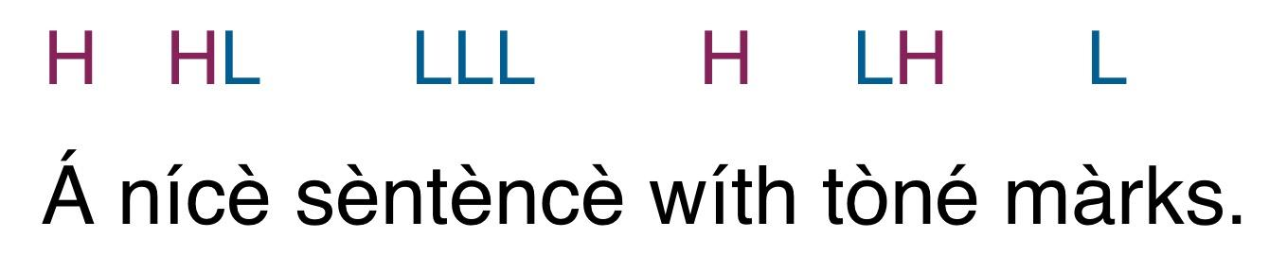
Tone Orthographies in Latin Scripts II
What about Tone Melodies/Tonal Patterns?
This analytical approach argues that the pitch “phrase” at the domain of the word operates as a single phonological unit. This method then comes in conflict with methods of analysis operating as if the domain of interpretation of pitch is solely the vowel.
Notes:
Bird, Steven. 1999. “When marking tone reduces fuency: an orthography experiment in Cameroon.” Language and Speech 42: 83–115.
Roberts, David. 2011. “A Tone Orthography Typology.” Written Language & Literacy 14 (1): 82–108. doi:10.1075/wll.14.1.05rob.
Snider, Keith L. 2014. “On Establishing Underlying Tonal Contrast.” Language Documentation & Conservation 8: 707–31. http://hdl.handle.net/10125/24622.
Snider, Keith L. 1990. “Tone in Proto‐Guang Nouns*.” African Languages and Cultures 3 (1): 87–105. doi:10.1080/09544169008717712.
Snider, Keith L. 1999. The Geometry and Features of Tone. Dallas, Texas: Summer Institute of Linguistics.
Snider, Keith L. 1999. “Tonal 'upstep' in Engenni.” Journal of West African Linguistics. 27 (1): 3–15.
Snider, Keith L. 1990. “Tonal Upstep in Krachi: Evidence for a Register Tier.” Language. 66 (3): 453–474
Paterson, Hugh J. III. 2015. “Phonetic transcription of tone in the IPA.” In The Scottish Consortium for ICPhS 2015 (Ed.). Proceedings of the 18th International Conference of Phonetic Sciences Paper number 507.1-5. University of Glasgow: Glasgow, UK.

Slide 27
Tone Orthographies in Latin Scripts II
What about Tone Melodies/Tonal Patterns?
This analytical approach argues that the pitch “phrase” at the domain of the word operates as a single phonological unit. This method then comes in conflict with methods of analysis operating as if the domain of interpretation of pitch is solely the vowel.
Bird’s method is not a great method because it is phonologically accurate, but rather because it is consistently countable.
It represents a structuralist approach to phonemic analysis applied to orthography.
Zero Tone Marking
Exhaustive Tone Marking
Notes:
Bird, Steven. 1999. “When marking tone reduces fuency: an orthography experiment in Cameroon.” Language and Speech 42: 83–115.
Roberts, David. 2011. “A Tone Orthography Typology.” Written Language & Literacy 14 (1): 82–108. doi:10.1075/wll.14.1.05rob.
Snider, Keith L. 2014. “On Establishing Underlying Tonal Contrast.” Language Documentation & Conservation 8: 707–31. http://hdl.handle.net/10125/24622.
Snider, Keith L. 1990. “Tone in Proto‐Guang Nouns*.” African Languages and Cultures 3 (1): 87–105. doi:10.1080/09544169008717712.
Snider, Keith L. 1999. The Geometry and Features of Tone. Dallas, Texas: Summer Institute of Linguistics.
Snider, Keith L. 1999. “Tonal 'upstep' in Engenni.” Journal of West African Linguistics. 27 (1): 3–15.
Snider, Keith L. 1990. “Tonal Upstep in Krachi: Evidence for a Register Tier.” Language. 66 (3): 453–474
Paterson, Hugh J. III. 2015. “Phonetic transcription of tone in the IPA.” In The Scottish Consortium for ICPhS 2015 (Ed.). Proceedings of the 18th International Conference of Phonetic Sciences Paper number 507.1-5. University of Glasgow: Glasgow, UK.

Slide 28
Tone Orthographies in Latin Scripts III
What happens if one is analyzing a language where a pattern occurs describable like: “No two high-pitches can occur sequentially”....
Notes:
Bird, Steven. 1999. “When marking tone reduces fuency: an orthography experiment in Cameroon.” Language and Speech 42: 83–115.
Roberts, David. 2011. “A Tone Orthography Typology.” Written Language & Literacy 14 (1): 82–108. doi:10.1075/wll.14.1.05rob.
Snider, Keith L. 2014. “On Establishing Underlying Tonal Contrast.” Language Documentation & Conservation 8: 707–31. http://hdl.handle.net/10125/24622.
Snider, Keith L. 1990. “Tone in Proto‐Guang Nouns*.” African Languages and Cultures 3 (1): 87–105. doi:10.1080/09544169008717712.
Snider, Keith L. 1999. The Geometry and Features of Tone. Dallas, Texas: Summer Institute of Linguistics.
Snider, Keith L. 1999. “Tonal 'upstep' in Engenni.” Journal of West African Linguistics. 27 (1): 3–15.
Snider, Keith L. 1990. “Tonal Upstep in Krachi: Evidence for a Register Tier.” Language. 66 (3): 453–474
Paterson, Hugh J. III. 2015. “Phonetic transcription of tone in the IPA.” In The Scottish Consortium for ICPhS 2015 (Ed.). Proceedings of the 18th International Conference of Phonetic Sciences Paper number 507.1-5. University of Glasgow: Glasgow, UK.

Slide 29
Tone Orthographies in Latin Scripts III
What happens if one is analyzing a language where a pattern occurs describable like: “No two high-pitches can occur sequentially”....
Depth: (Roberts)
Notes:
Bird, Steven. 1999. “When marking tone reduces fuency: an orthography experiment in Cameroon.” Language and Speech 42: 83–115.
Roberts, David. 2011. “A Tone Orthography Typology.” Written Language & Literacy 14 (1): 82–108. doi:10.1075/wll.14.1.05rob.
Snider, Keith L. 2014. “On Establishing Underlying Tonal Contrast.” Language Documentation & Conservation 8: 707–31. http://hdl.handle.net/10125/24622.
Snider, Keith L. 1990. “Tone in Proto‐Guang Nouns*.” African Languages and Cultures 3 (1): 87–105. doi:10.1080/09544169008717712.
Snider, Keith L. 1999. The Geometry and Features of Tone. Dallas, Texas: Summer Institute of Linguistics.
Snider, Keith L. 1999. “Tonal 'upstep' in Engenni.” Journal of West African Linguistics. 27 (1): 3–15.
Snider, Keith L. 1990. “Tonal Upstep in Krachi: Evidence for a Register Tier.” Language. 66 (3): 453–474
Paterson, Hugh J. III. 2015. “Phonetic transcription of tone in the IPA.” In The Scottish Consortium for ICPhS 2015 (Ed.). Proceedings of the 18th International Conference of Phonetic Sciences Paper number 507.1-5. University of Glasgow: Glasgow, UK.

Slide 30
Hard to Use… (the cognitive domain)
What does “hard to use” really mean?
Notes:
Bird, Steven. 1999. “When marking tone reduces fuency: an orthography experiment in Cameroon.” Language and Speech 42: 83–115.
Roberts, David. 2011. “A Tone Orthography Typology.” Written Language & Literacy 14 (1): 82–108. doi:10.1075/wll.14.1.05rob.
Snider, Keith L. 2014. “On Establishing Underlying Tonal Contrast.” Language Documentation & Conservation 8: 707–31. http://hdl.handle.net/10125/24622.
Snider, Keith L. 1990. “Tone in Proto‐Guang Nouns*.” African Languages and Cultures 3 (1): 87–105. doi:10.1080/09544169008717712.
Snider, Keith L. 1999. The Geometry and Features of Tone. Dallas, Texas: Summer Institute of Linguistics.
Snider, Keith L. 1999. “Tonal 'upstep' in Engenni.” Journal of West African Linguistics. 27 (1): 3–15.
Snider, Keith L. 1990. “Tonal Upstep in Krachi: Evidence for a Register Tier.” Language. 66 (3): 453–474
Paterson, Hugh J. III. 2015. “Phonetic transcription of tone in the IPA.” In The Scottish Consortium for ICPhS 2015 (Ed.). Proceedings of the 18th International Conference of Phonetic Sciences Paper number 507.1-5. University of Glasgow: Glasgow, UK.

Slide 31
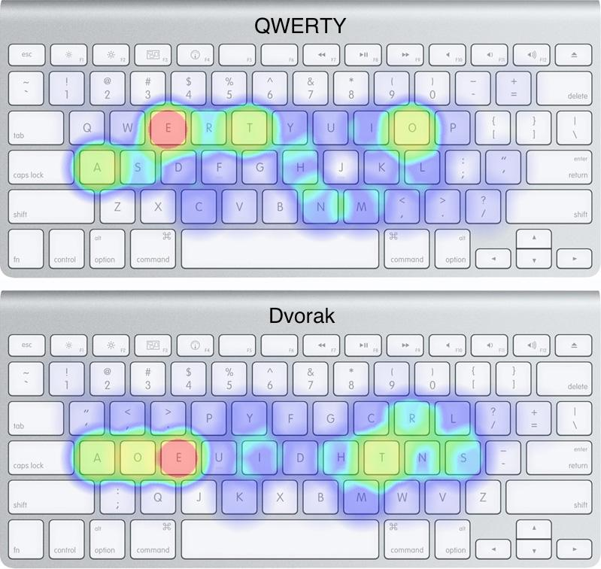
Hard to Use… (The Haptic & Psychological domains)
What does “hard to use” really mean?
QWERTY vs. Dvorak
“It is bonkers how much work this is. I just took 40 minutes to type 300 words and ran out of patience about 250 words ago. Getting a letter wrong makes me want to throw a chair. The S key being on the other side of the keyboard, under a pinky… I mean.” — CASEY JOHNSTON in ars Technica
Notes:
Bird, Steven. 1999. “When marking tone reduces fuency: an orthography experiment in Cameroon.” Language and Speech 42: 83–115.
Roberts, David. 2011. “A Tone Orthography Typology.” Written Language & Literacy 14 (1): 82–108. doi:10.1075/wll.14.1.05rob.
Snider, Keith L. 2014. “On Establishing Underlying Tonal Contrast.” Language Documentation & Conservation 8: 707–31. http://hdl.handle.net/10125/24622.
Snider, Keith L. 1990. “Tone in Proto‐Guang Nouns*.” African Languages and Cultures 3 (1): 87–105. doi:10.1080/09544169008717712.
Snider, Keith L. 1999. The Geometry and Features of Tone. Dallas, Texas: Summer Institute of Linguistics.
Snider, Keith L. 1999. “Tonal 'upstep' in Engenni.” Journal of West African Linguistics. 27 (1): 3–15.
Snider, Keith L. 1990. “Tonal Upstep in Krachi: Evidence for a Register Tier.” Language. 66 (3): 453–474
Paterson, Hugh J. III. 2015. “Phonetic transcription of tone in the IPA.” In The Scottish Consortium for ICPhS 2015 (Ed.). Proceedings of the 18th International Conference of Phonetic Sciences Paper number 507.1-5. University of Glasgow: Glasgow, UK.
https://arstechnica.com/gadgets/2014/03/my-quest-to-learn-the-dvorak-keyboard-layout-part-1/

Slide 32
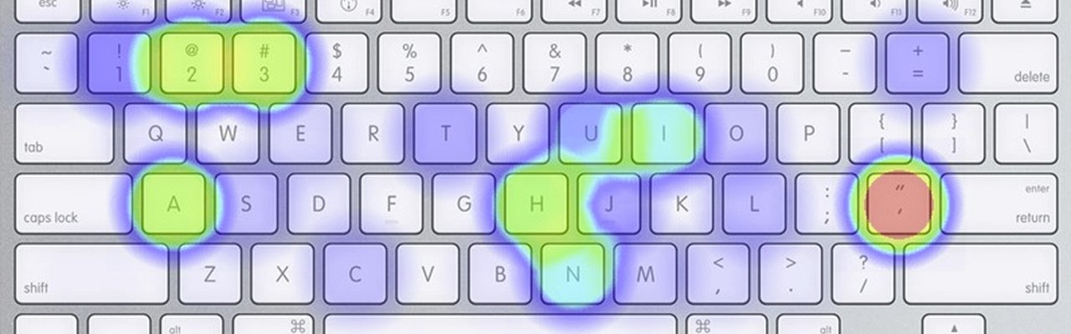
Hard to Use… (the haptic domain)
What does “hard to use” really mean?
Notes:
Bird, Steven. 1999. “When marking tone reduces fuency: an orthography experiment in Cameroon.” Language and Speech 42: 83–115.
Roberts, David. 2011. “A Tone Orthography Typology.” Written Language & Literacy 14 (1): 82–108. doi:10.1075/wll.14.1.05rob.
Snider, Keith L. 2014. “On Establishing Underlying Tonal Contrast.” Language Documentation & Conservation 8: 707–31. http://hdl.handle.net/10125/24622.
Snider, Keith L. 1990. “Tone in Proto‐Guang Nouns*.” African Languages and Cultures 3 (1): 87–105. doi:10.1080/09544169008717712.
Snider, Keith L. 1999. The Geometry and Features of Tone. Dallas, Texas: Summer Institute of Linguistics.
Snider, Keith L. 1999. “Tonal 'upstep' in Engenni.” Journal of West African Linguistics. 27 (1): 3–15.
Snider, Keith L. 1990. “Tonal Upstep in Krachi: Evidence for a Register Tier.” Language. 66 (3): 453–474
Paterson, Hugh J. III. 2015. “Phonetic transcription of tone in the IPA.” In The Scottish Consortium for ICPhS 2015 (Ed.). Proceedings of the 18th International Conference of Phonetic Sciences Paper number 507.1-5. University of Glasgow: Glasgow, UK.

Slide 33
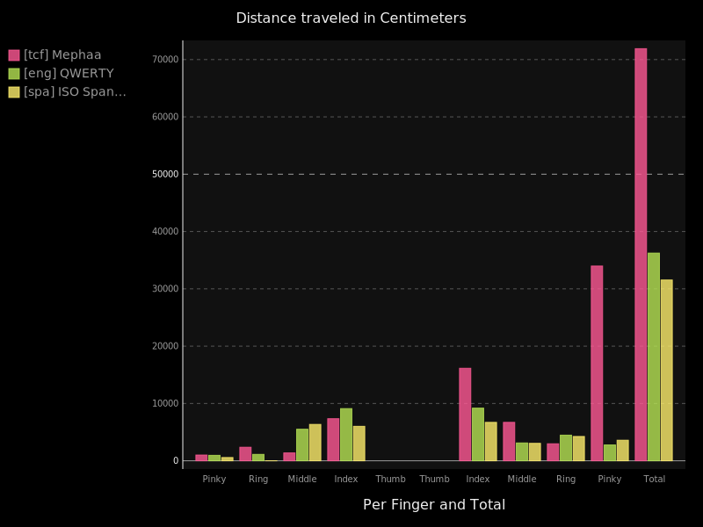
Hard to Use… (the distance measure)
What does “hard to use” really mean?
The same translated text across three languages:
English - Green
Spanish - Yellow
Meꞌphaa - Rose
Right-hand heavy… Pinky heavy
Notes:
Bird, Steven. 1999. “When marking tone reduces fuency: an orthography experiment in Cameroon.” Language and Speech 42: 83–115.
Roberts, David. 2011. “A Tone Orthography Typology.” Written Language & Literacy 14 (1): 82–108. doi:10.1075/wll.14.1.05rob.
Snider, Keith L. 2014. “On Establishing Underlying Tonal Contrast.” Language Documentation & Conservation 8: 707–31. http://hdl.handle.net/10125/24622.
Snider, Keith L. 1990. “Tone in Proto‐Guang Nouns*.” African Languages and Cultures 3 (1): 87–105. doi:10.1080/09544169008717712.
Snider, Keith L. 1999. The Geometry and Features of Tone. Dallas, Texas: Summer Institute of Linguistics.
Snider, Keith L. 1999. “Tonal 'upstep' in Engenni.” Journal of West African Linguistics. 27 (1): 3–15.
Snider, Keith L. 1990. “Tonal Upstep in Krachi: Evidence for a Register Tier.” Language. 66 (3): 453–474
Paterson, Hugh J. III. 2015. “Phonetic transcription of tone in the IPA.” In The Scottish Consortium for ICPhS 2015 (Ed.). Proceedings of the 18th International Conference of Phonetic Sciences Paper number 507.1-5. University of Glasgow: Glasgow, UK.

Slide 34
Meꞌphaa text input patterns
Notes:
Dead Keys….

Slide 35
Let’s As a Question:
Language as Instrument
Language as Object
Bourdieu, Pierre. 1977. “The economics of linguistic exchanges.” Social Science Information 16(6). 645–668. doi:10.1177/053901847701600601
Notes:
Bourdieu, Pierre. 1977. “The economics of linguistic exchanges.” Social Science Information 16(6). 645–668. doi:10.1177/053901847701600601

Slide 36
Let’s As a Question:
What are the real cost factors when considering typing in multilingual communicative environments?... To what degree is the technology factor quantifiable?
Language as Instrument
Language as Object
Bourdieu, Pierre. 1977. “The economics of linguistic exchanges.” Social Science Information 16(6). 645–668. doi:10.1177/053901847701600601
Notes:
Bourdieu, Pierre. 1977. “The economics of linguistic exchanges.” Social Science Information 16(6). 645–668. doi:10.1177/053901847701600601
Where is the ROI line? What are the perceived factors for evaluating ROI and do these actually impact behavior?

Slide 37
The Experiment Design
Use a Parallel corpus
Select two keyboards per language
Decompose the corpora to keystroke values
Apply weight-based rankings to keystroke strings.
Weight-based rankings are applied on two factors:
location relative to rest position
Modeled finger
Compare models without accounting for language

Slide 38
The Evidence Evaluated I
Keyboard Layout | Language
QWERTY | English
Dvorak | English
AZERTY | French
Bépo | French
AFU | Eastern Dan
Trans-Mande | Eastern Dan

Slide 39
The Evidence Evaluated II
James in English (NLT)
Newspaper Collection in Eastern Dan
James in French (Darby 1885)
James in Eastern Dan (Wycliffe 1991/2016)

Slide 40
The Evidence Evaluated III
Corpus | Orthographic Words | Unicode Grapheme Clusters | Unique Characters
eng-James | 2,531 | 13,371 | 61
fra-James | 2,378 | 13,372 | 68
dnj-James | 5,197 | 23,958 | 61
dnj-Full | 84,268 | 399,971 | 99

Slide 41
The Evidence Evaluated III
Keyboard Layout | Language | Fitness Score | Corpus
QWERTY | English | 3362 | James
Dvorak | English | 1642 | James
AZERTY | French | 3358 | James
Bépo | French | 1472 | James
AFU | French | 3345 | James
Trans-Mande | French | 3588 | James
AFU | Eastern Dan | 17922 | James
Trans-Mande | Eastern Dan | 22723 | James

Slide 42
The Evidence Evaluated III
For the Eastern Dan writer, it takes about 5.3 times the typing effort when compared with the effort required to type the national language of the region.

Slide 43
The Economics of Linguistic Exchanges
For the Eastern Dan writer, it takes about 5.3 times the typing effort when compared with the effort required to type the national language of the region.
Language as Instrument
Language as Object
Multilingual environments allow for users to ask the questions: For what linguistic exchange is ___x___ language optimal?
Bourdieu, Pierre. 1977. “The economics of linguistic exchanges.” Social Science Information 16(6). 645–668. doi:10.1177/053901847701600601
Notes:
Bourdieu, Pierre. 1977. “The economics of linguistic exchanges.” Social Science Information 16(6). 645–668. doi:10.1177/053901847701600601

Slide 44
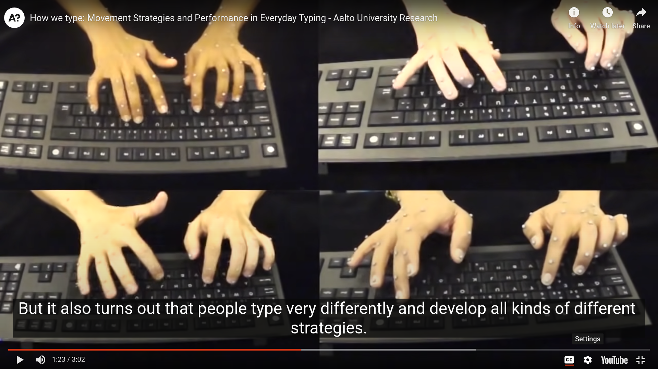
The Evaluation Methods

Slide 45
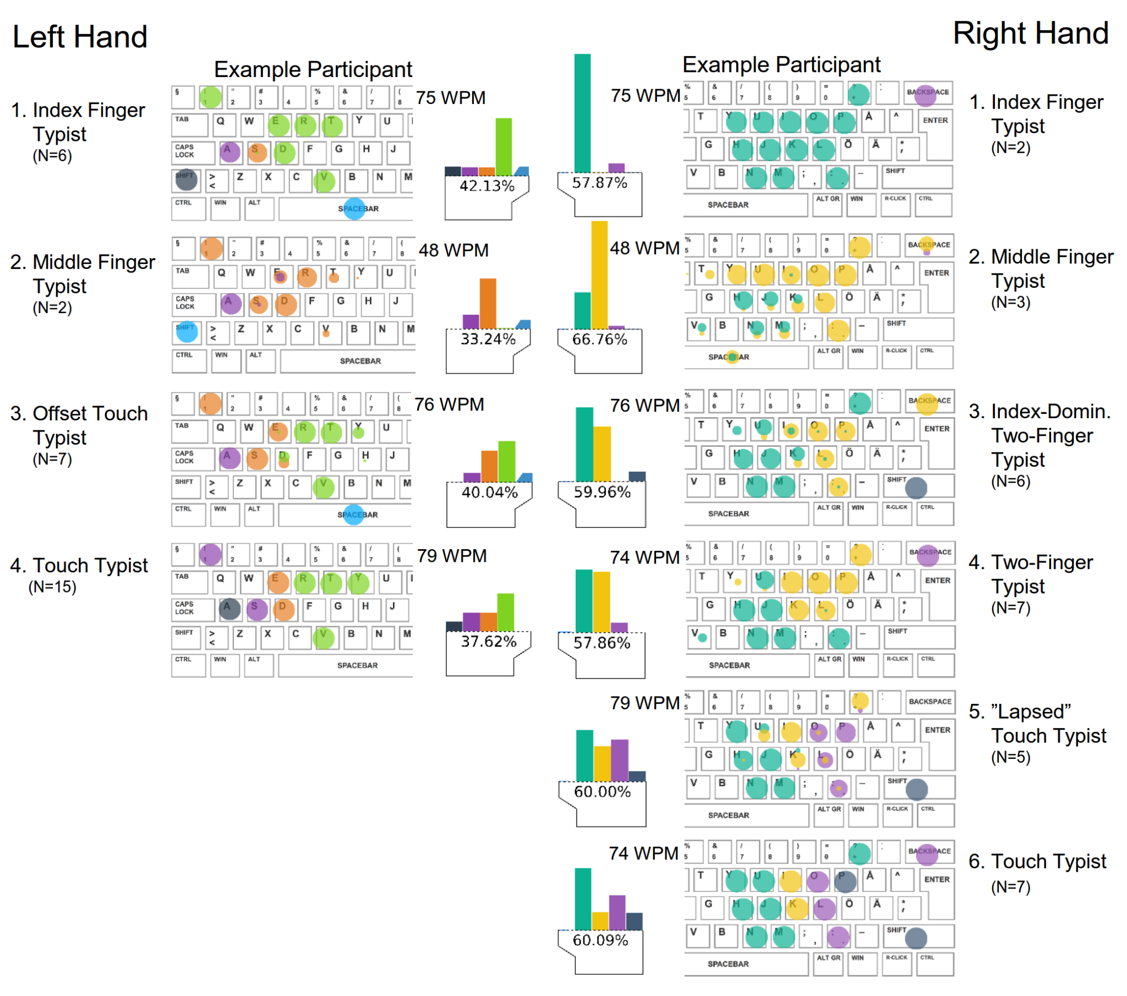
Evaluating the Standard Assumption
Feit et al. (2016) How We Type: Movement Strategies and Performance in Everyday Typing. — a must read for anyone working on typing.
They present a typology of typing strategies
Based on empirical observation
Supported by open access data
The Data includes the English and Finnish.
They suggest that the standard model may not apply.
Notes:
Feit, A., Weir, D. & Oulasvirta, A. (2016). How We Type: Movement Strategies and Performance in Everyday Typing. ACM. https://doi.org/10.1145/2858036.2858233

Slide 46
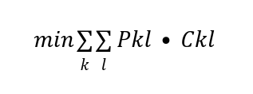
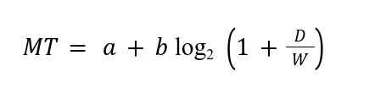
Future Experimental Work I
Currently the keyboard layout assignment problem is expressed as the following:
Where kl represent bigrams. And where C is a formulation of Shannon's law:
Notes:
As we have seen, not all bigrams (two unicode character sequences) are digraphs (two letter sequences representing a single orthographical unit). In latin script orthographies indicating tone, some digraphs are nonsequential (tone melodies/tone patterns). Optimization to this point has focused on haptic interactions in languages where bigrams are generally represented by two “letters” and where multigraphs are sequential. Future work should integrate the tone orthography typology considerations, and the models known empirical models that typists use. Optimization should also look towards optimizing at the level of “least cognitively disruptive” rather than purely looking at character frequency.

Slide 47
Future Experimental Work II
We have seen:
not all bigrams (two unicode character sequences) are digraphs (two letter sequences representing a single orthographical unit).
in latin script orthographies indicating tone, some digraphs are nonsequential (tone melodies/tone patterns).
Optimization to this point has focused on haptic interactions in languages where bigrams are generally represented by two “letters” and where multigraphs are sequential. Future work should integrate the tone orthography typology considerations, and the models known empirical models that typists use. Optimization should also look towards optimizing at the level of “least cognitively disruptive” rather than purely looking at character frequency.
Notes:
As we have seen, not all bigrams (two unicode character sequences) are digraphs (two letter sequences representing a single orthographical unit). In latin script orthographies indicating tone, some digraphs are nonsequential (tone melodies/tone patterns). Optimization to this point has focused on haptic interactions in languages where bigrams are generally represented by two “letters” and where multigraphs are sequential. Future work should integrate the tone orthography typology considerations, and the models known empirical models that typists use. Optimization should also look towards optimizing at the level of “least cognitively disruptive” rather than purely looking at character frequency.

Slide 48
Future Experimental Work III
A more articulated algorithm for defining orthographic complexity in an effort to describe psychological reality.
Counting orthographic density by tonal melody/tonal pattern
Counting cognitively interruptive orthographic design, multi-graphs — both non-concatenative and concatenative
Counting multi-stroke non-multigraphs
Field testing and lab based testing with eye tracking, video observation, and motion sensing technology.

Slide 49
Cross-Disciplinary Relevant Questions
Psychology & Neuroscience:
How does brain processing of haptic patterns align with brain processing of read patterns and spoken patterns in language?
Sociology of Language:
How interruptive is too interruptive? At which point will people choose a new language in which to communicate?
Orthography and Writing Studies:
How do pronunciation and meaning mappings to graphemes impact communication?
Information and computational Science:
How do we define the search-space and then how do we search it efficiently for optimal keyboard layout arrangements?

Slide 50
Other Presentations and Publications
Publications:
Paterson III, Hugh J. 2015. Keyboard Layouts: Lessons from the Meꞌphaa and Sochiapam Chinantec Designs. In Mari C. Jones, Endangered Languages and New Technologies, 49–66. Cambridge, UK: Cambridge University Press. doi:10.1017/CBO9781107279063.006
Presentations:
Paterson III, Hugh J. 2015. African Languages: Assessing the Text Input Difficulty. Paper presented at: 46th Annual Conference of African Linguistics. University of Oregon. March 26th – 28th. https://hughandbecky.us/Hugh-CV/talk/2015-africa-assessing-thedifficulty-of-text-input
Paterson III, Hugh J. 2015. Assessing the Difficulty of the Text Input Task for Minority Languages. Paper presented at: 4th International Conference on Language Documentation & Conservation. Ala Moana Hotel in Honolulu, HI. February 26th – March 1st. http://hdl.handle.net/10125/25318
Paterson III, Hugh J. 2012. Keyboard Layout as Part of Language Documentation:The Case of the Me'phaa and Chinantec Keyboards. Paper presented at: Language Endangerment: Methodologies and New Challenges, CRASSH. Cambridge, United Kingdom. July 6th. https://hughandbecky.us/Hugh-CV/talk/2012-keyboard-layout-presentation

Slide 51
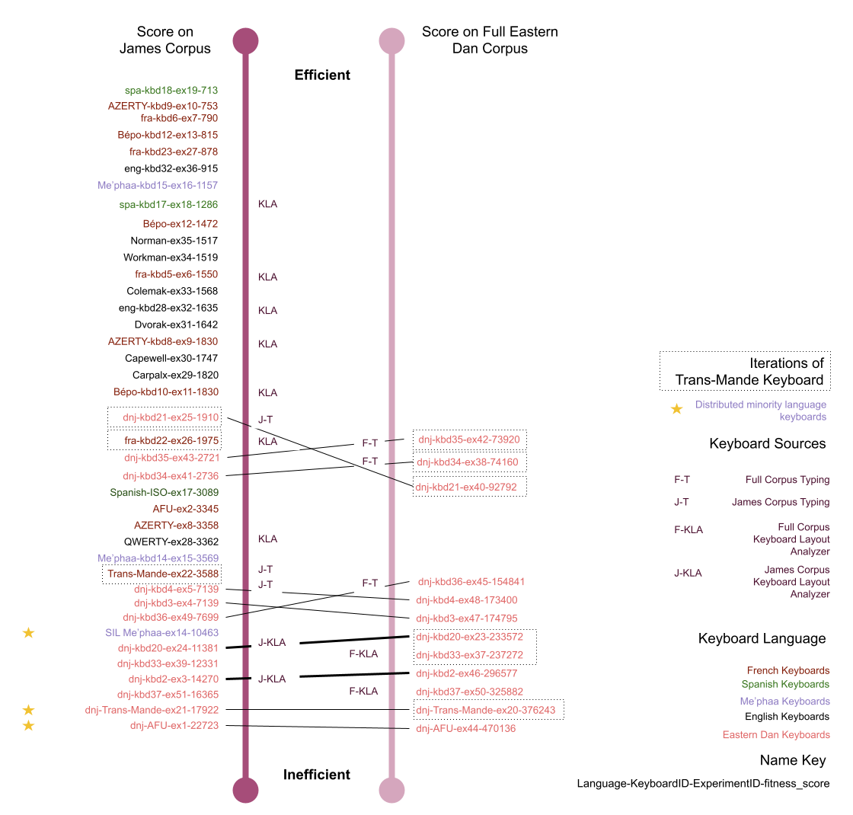

A Parallel Look
https://hughandbecky.us/Hugh-CV/post/keyboard-comparisons

Slide 52
A Parallel Look

Slide 53
A Parallel Look

